Slide 1
Mountain grassland dynamics: integrating phenotypic plasticity in a new agent-based model
Ph.D. defence of
Clément Viguier
realised under the supervision of
Björn Reineking
at IRSTEA Grenoble - TEGR

Slide 2
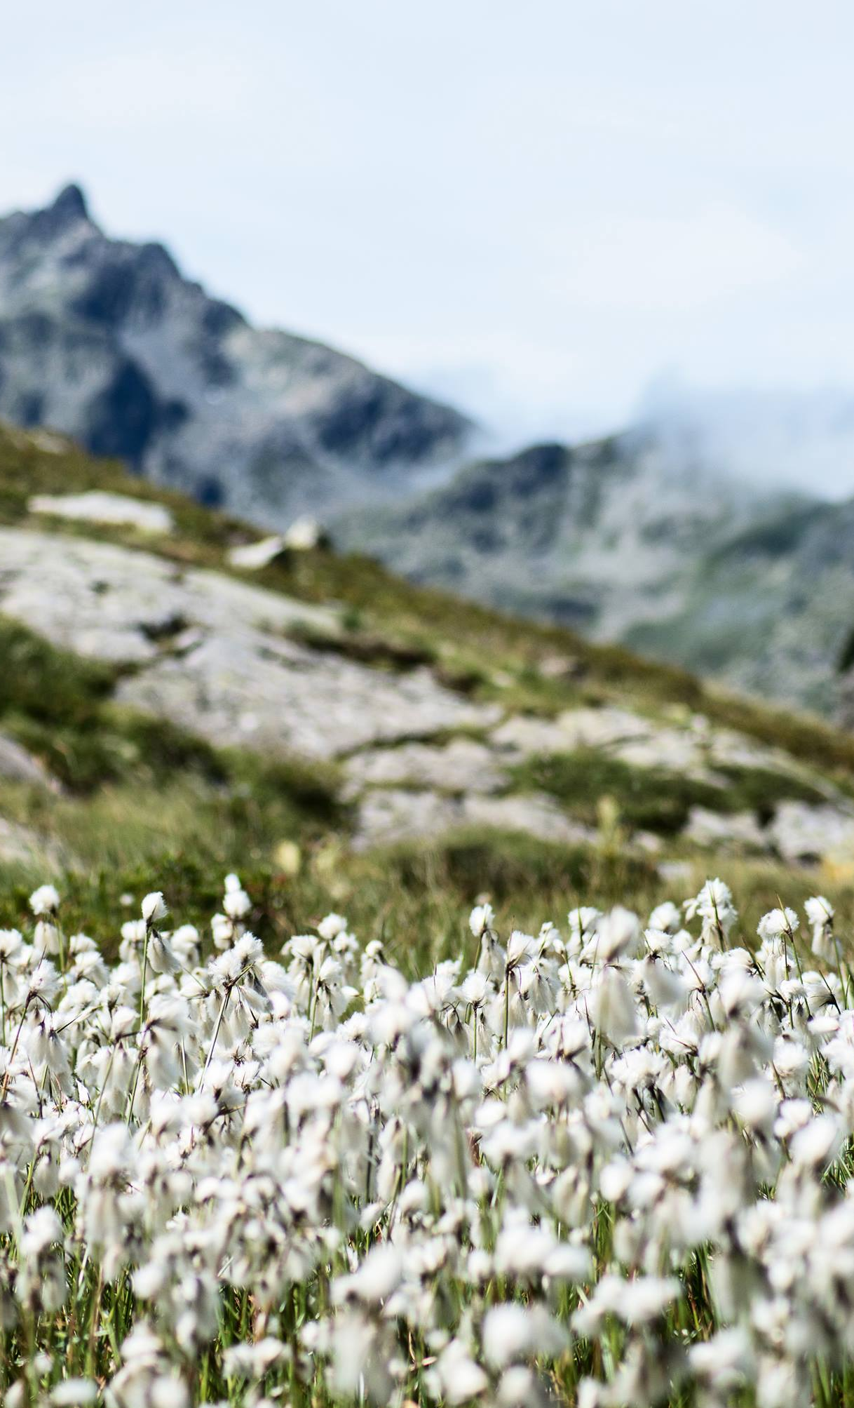
Context
1
Mountain grasslands in a changing world

Slide 3
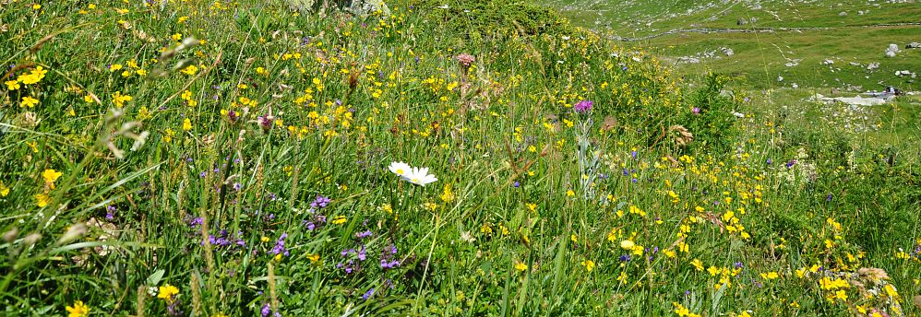
The value of mountain grasslands’ diversity.

Slide 4
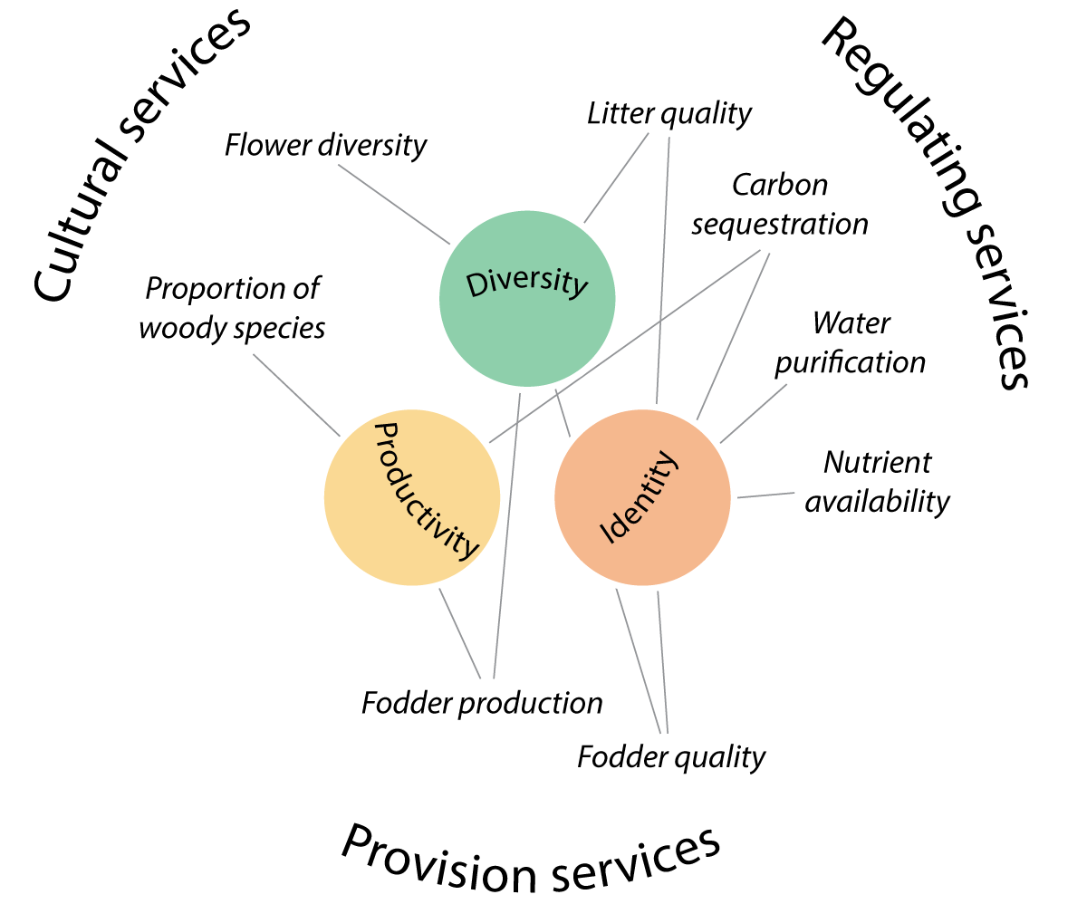
Ecosystem services
Benefits that humans freely gain from the natural environment
Argument for nature conservation
Tool for management

Slide 5
Assessing grassland ecosystem services
Trait: morphological, anatomical, biochemical, physiological or phenological features of individuals or their component organs or tissues - TRY database
Drivers
Description of
community
Summary statistics
Services
Measure
Model
Compute
Estimate

Slide 6
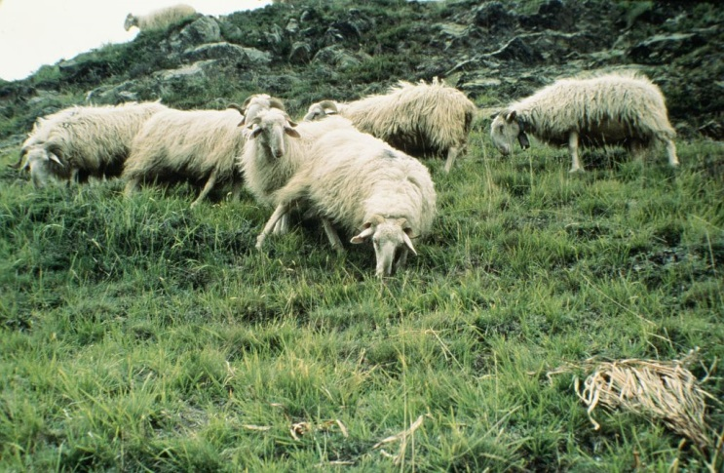
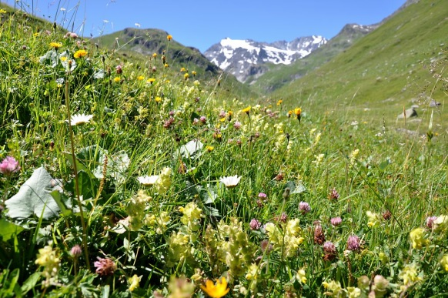
Drivers, global change and services
Summary statistics
Project
Model
Compute
Estimate

Slide 7
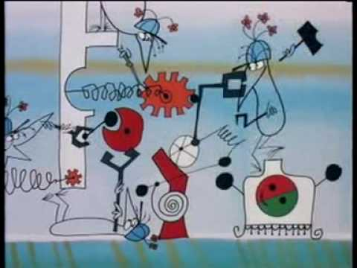
Models to understand and predict
Understanding by explaining
Emerging behaviour
Allow exrtapolations
Experiment at low cost

Slide 8
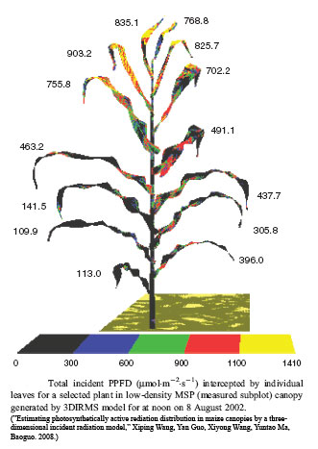
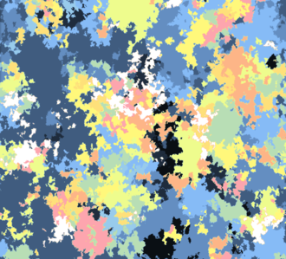
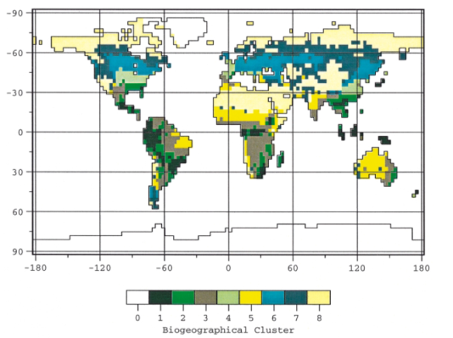
A gap to fill
Combine the species diversity and ecological processes of large scale models with the plant level processes of small scale models.
Molécular
Organ
Individual
Communuty
Landscape
S<
s, min
h, j
j
j, week
mm
cm
cm, m
m, km
Physiological model
Growth/development model
DGVMs

Slide 9
Intra-specific variability matters and impacts the community responses
CWM
ISV
Jung 2014
Up to 40% of the total variability of some traits.
Strong impact on community response

Slide 10
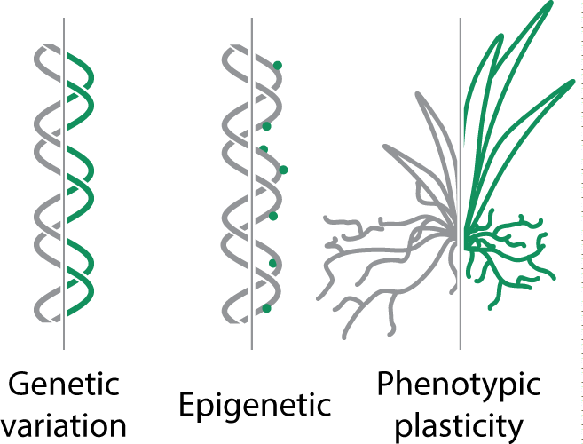
Phenotypic plasticity, one source of variation
Plasticity
Often overlooked.
Hard to study in empircal studies.
Potential for rapid adaptation to climate change.
Potential for mitigation of the effects of environmental variability.

Slide 11
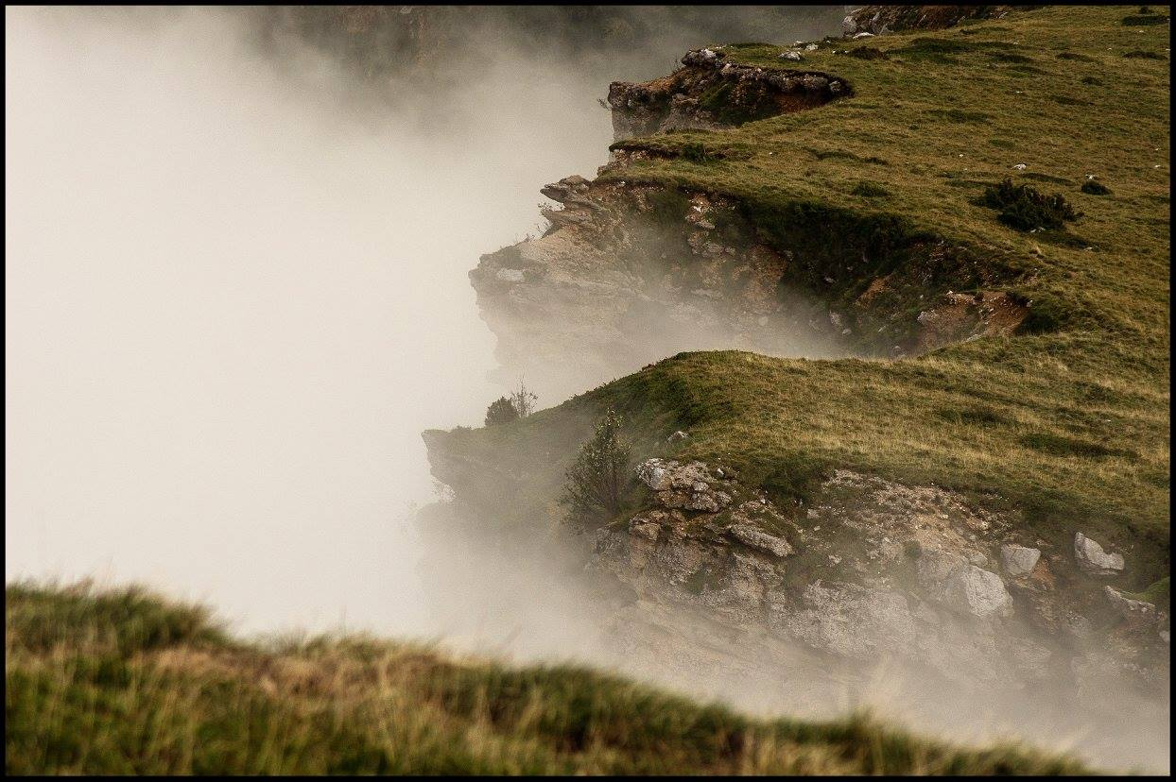
Questions
2
Technical and scientific interrogations

Slide 12
How does phenotypic plasticity impact grassland community properties & dynamics?

Slide 13
How does phenotypic plasticity impact grassland community properties?
How model diverse plant communities integrating phenotypic plasticity?

Slide 14
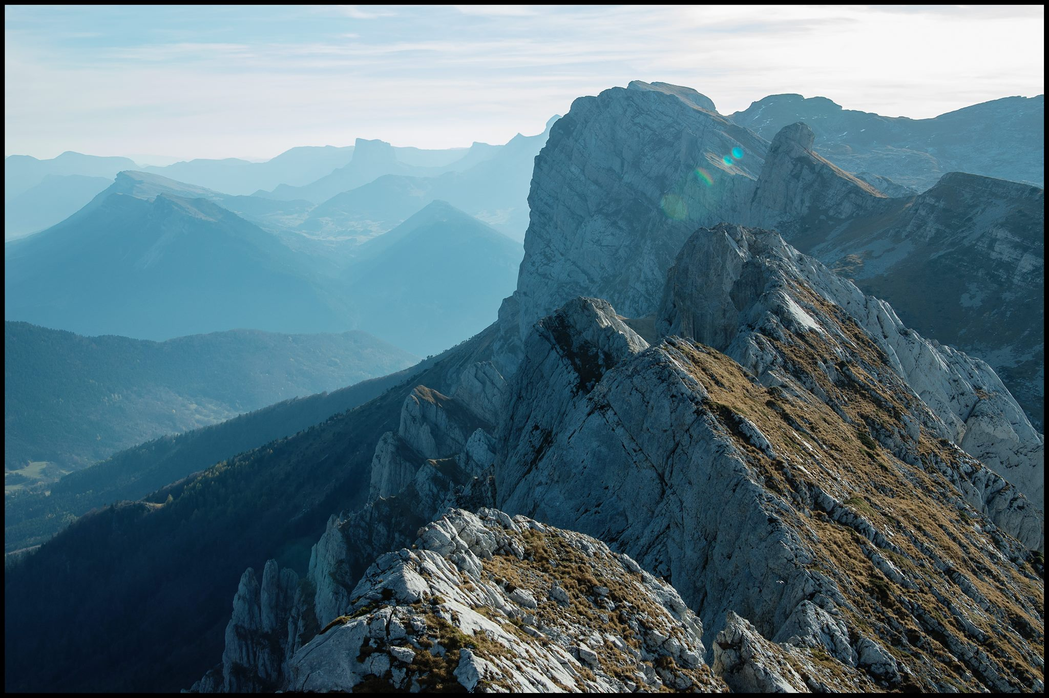
Introduction
3
State of the art and concepts

Slide 15

Keys concepts

Slide 16
The concept of niche
How a species fit in a set of env. conditions.
Hutchinton: n-dimension volume.
Translate the impact of an environmental factor on the fitness function (growth, survival and reproduction)
Affected by biotic condition fundamental → realised
Despite the similar functioning
Why do not plant share the same niche?

Slide 17
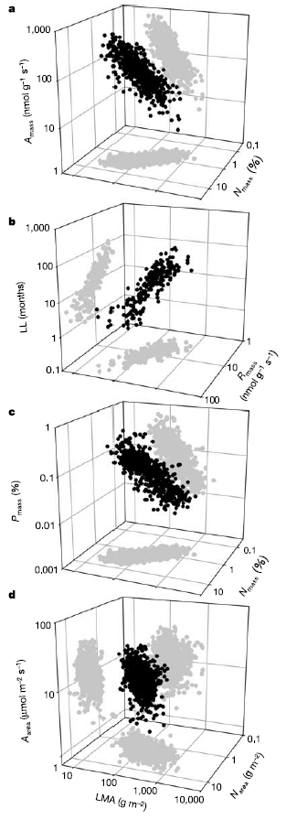
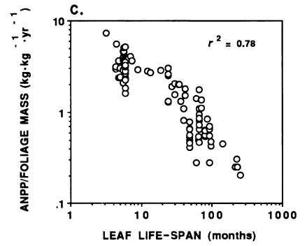
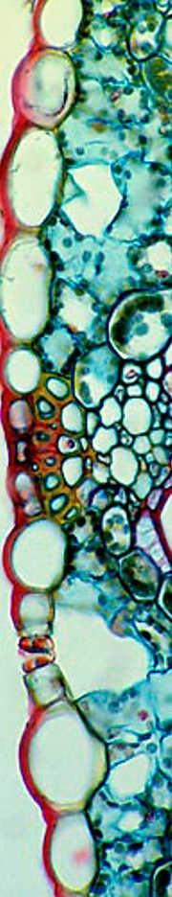
The leaf economic spectrum
Variation in structure and resource use
Emerge from ecological and biological constraints
Allow simplification of plant classification
Partly explain by the trade-off between active and structural tissues
P. Reich (1992)
Wright et al. (2003)

Slide 18
Trade-offs and strategy space
Generalise trade-offs to other processes: roots exchanges, reproductions, etc…
Continuous axis, convenient for modelling
Same functioning framework but species differences
Strategy space.
- How does plasticity fits in this framework ?

Slide 19
Plant functionning and interactions

Slide 20
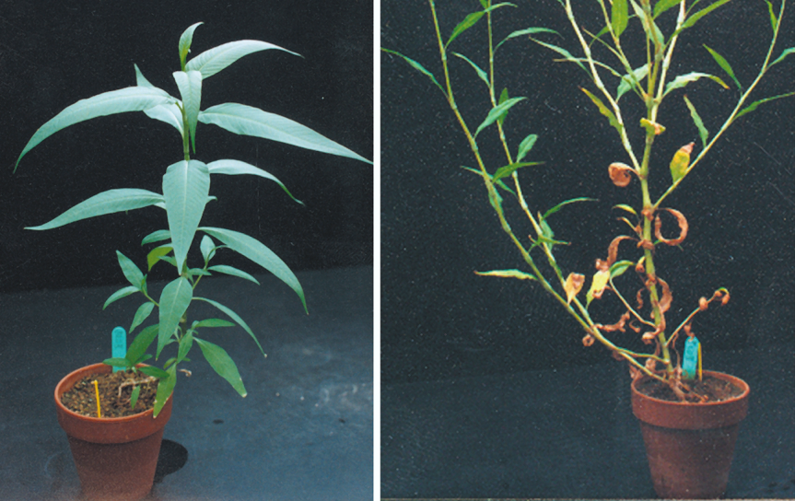
About phenotypic plasticity

Slide 21
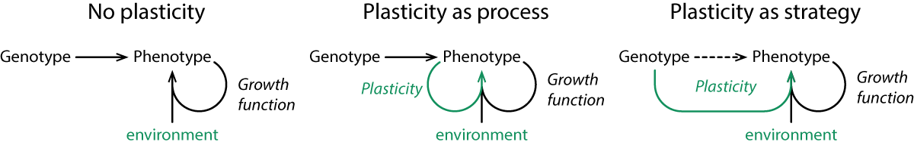
Plasticity as a strategy
Active plasticity: anticipatory, and often highly integrated, phenotypic changes in response to some environmental cue

Slide 22
Modelling plasticity
Finalist perspective
Plasticity in models: dimensions, objectives and assumptions
Dimensions: what traits are plastic,
Objective: what drives the changes,
Assumptions: implicit or explicit rules
How does palsticity impact properties and dynamics of plant communities?

Slide 23
Modelling plasticity
Functional equilibrium and resource use

Slide 24
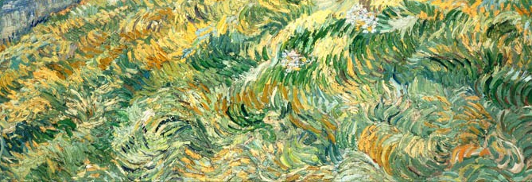
Main effects of plasticity

Slide 25
Widenning niches

Slide 26
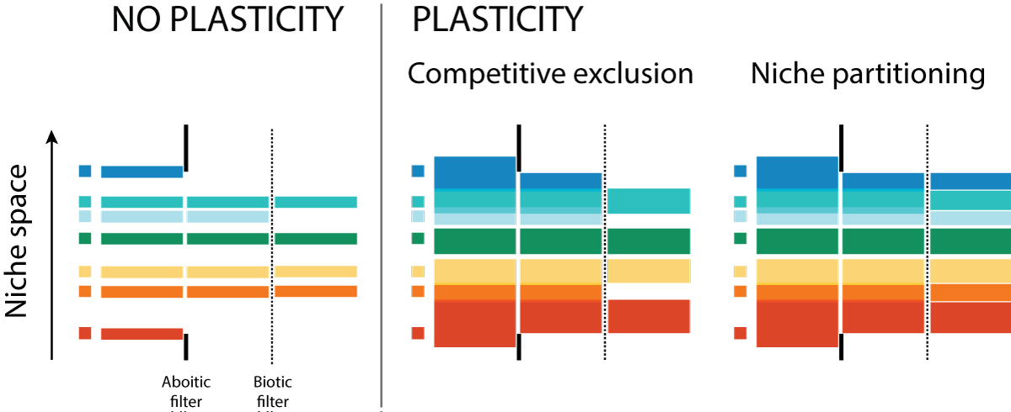
Effect on community’s diversity
Niche partitionning vs competitve exclusion

Slide 27
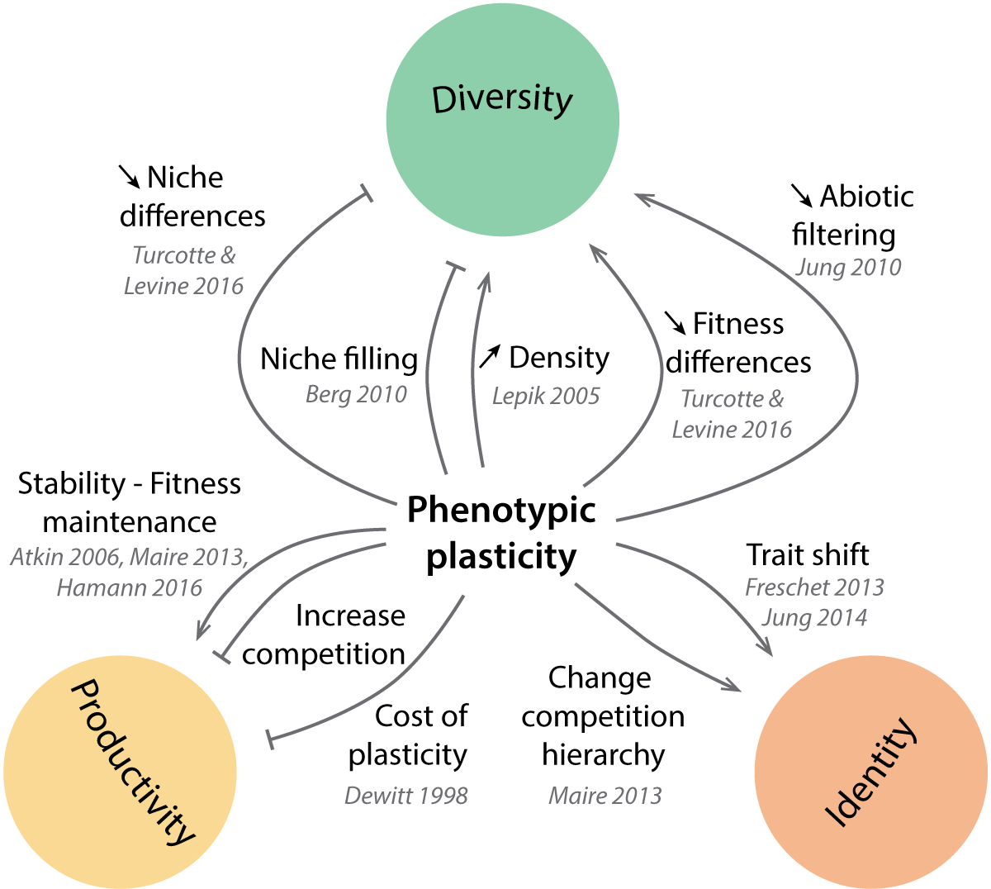
We do not agree, yet
All effects

Slide 28
We do not agree, yet
All effects

Slide 29
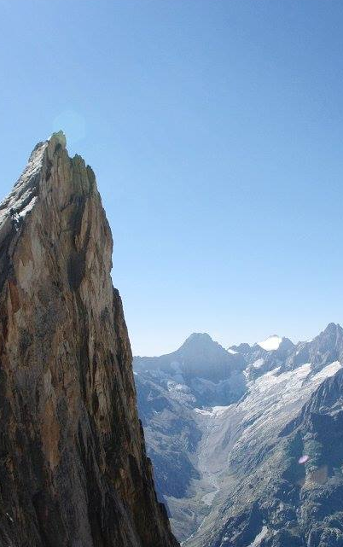
Results
4
Presentation of MountGrass
Individual- and community-level effects of plasticity

Slide 30
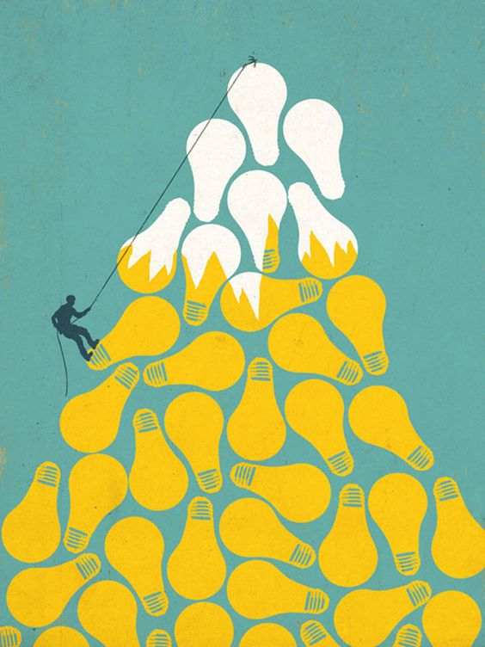
Model overview

Slide 31
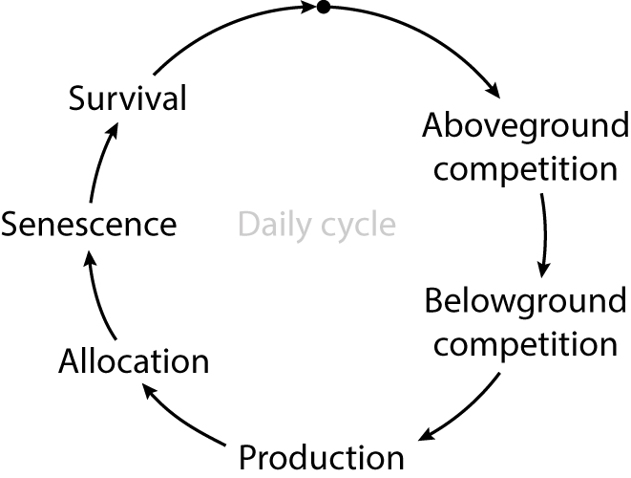
MountGrass’ world representation
Obj: community properties and dynamics emerge from plant fcting. → individual
IBM spatially explicit
Scales and resolutions
Cm, day
Seasons
Grid

Slide 32
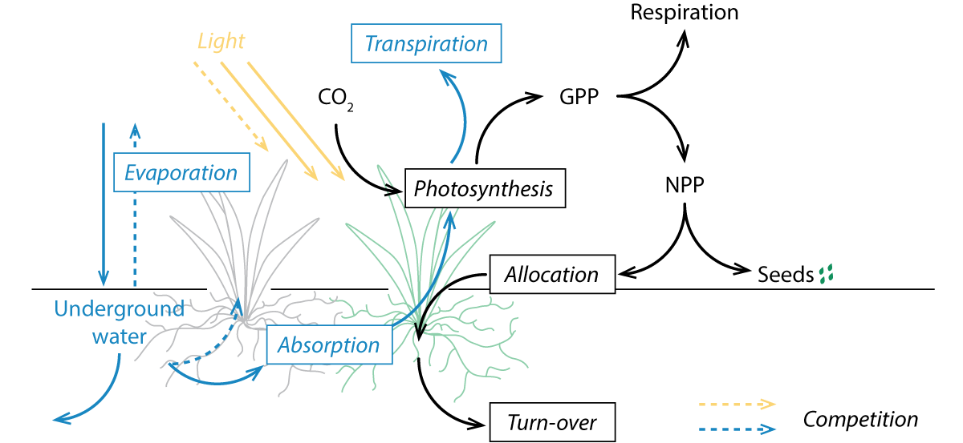
MountGrass’ processes
Main processes

Slide 33

Plant representation
Based on trade-offs and strategy space
4 vegetative compartments
Par, pas, r:s
Different dry volumic masses → Change the cost of exchange area
But also alters turn-over and respiration
How does the phenotype impact the plant growth?

Slide 34
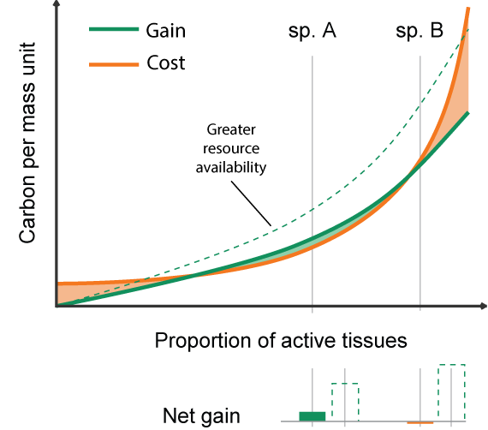
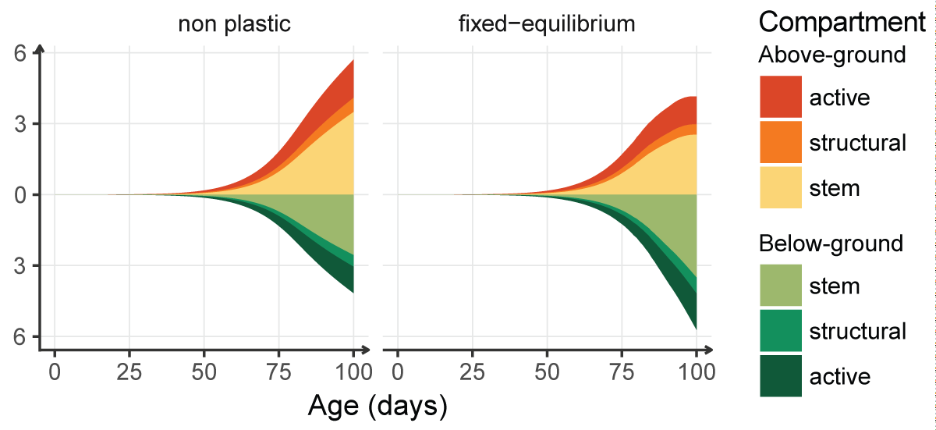
The components of plant growth
TISSUE EFFICIENCY
BALANCE
How does plasticity fit this representation and drive the phenotype ?

Slide 35
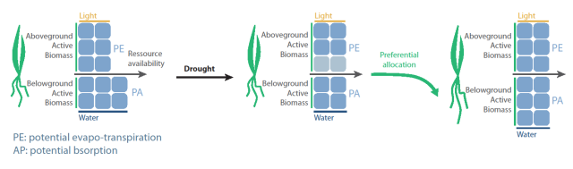
Algorithms
Objective functions
Plastic dimensions
Assumptions
Objective function: equilibrium, axis: root:shoot ratio
One among 3
Just rules, not a strategy

Slide 36
The future: between species memory and individual experience
How make it a strategy, and not only a process ? Make the projection definition species specific
Memory: genetic memory of the species
Reactivity: relative weight given to the individual experience
Experience
Memory
Reactivity

Slide 37
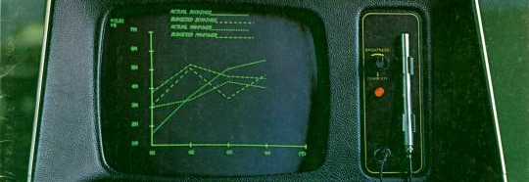
Simulation results

Slide 38
From the individual to the community.
INDIVIDUAL
COMMUNITY
Understand components of plant growth
Link strategies and the potential niche
Study the effect of plasticity on potential niche
Test realised effects on community properties
Understand the balance between filtering mechanisms

Slide 39
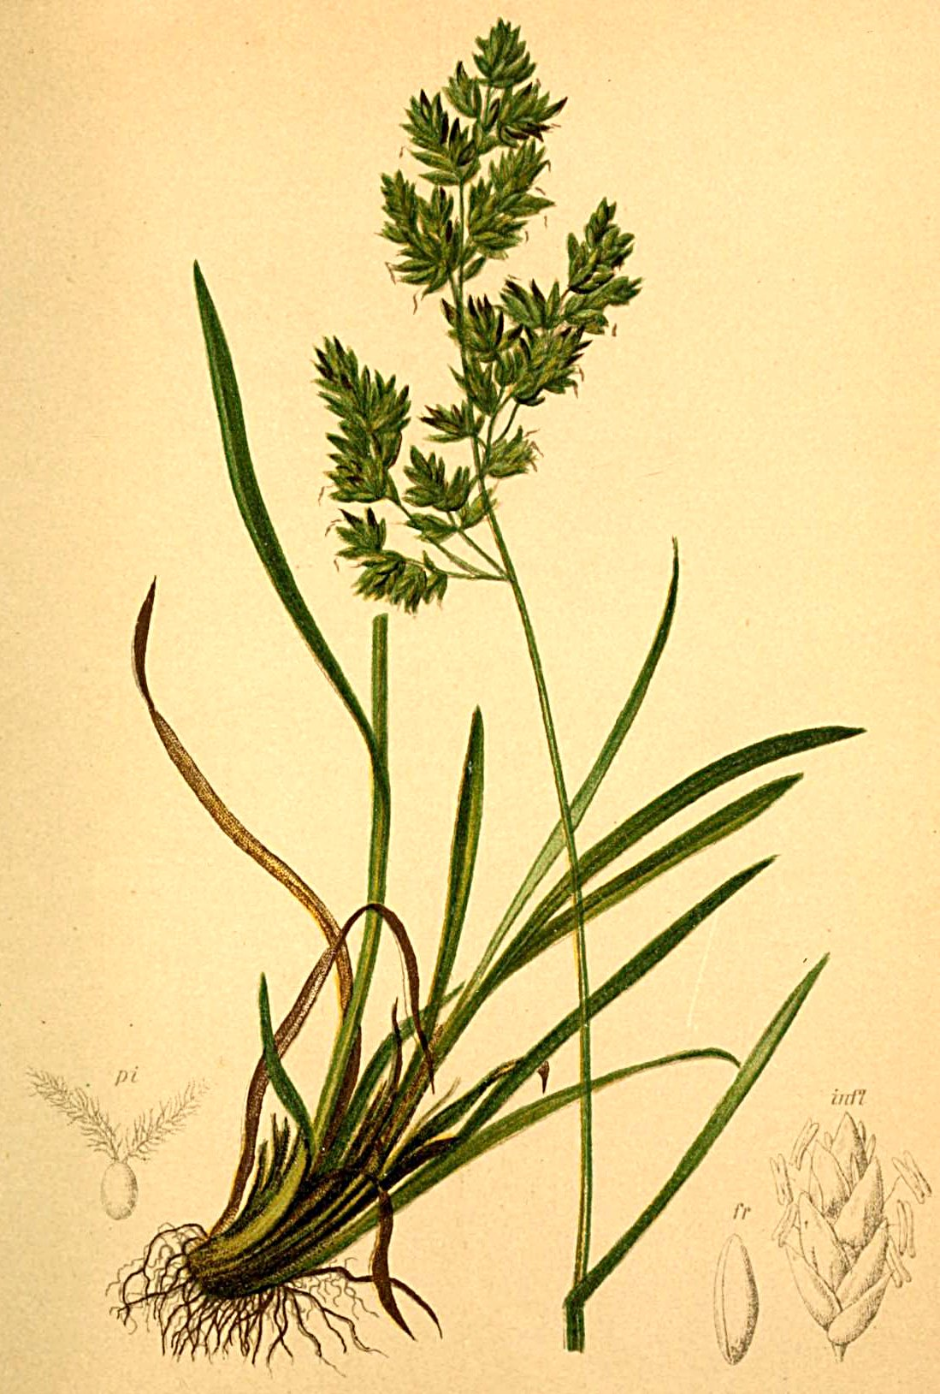
Individual-level simulations
The plasticity and the potential niche

Slide 40
Simulation set-up
Simulations
20 Parameter sets
Plastic and non plastic
Gradient of water availability
N * m phenotypes
Each simulation
Size/lenght

Slide 41
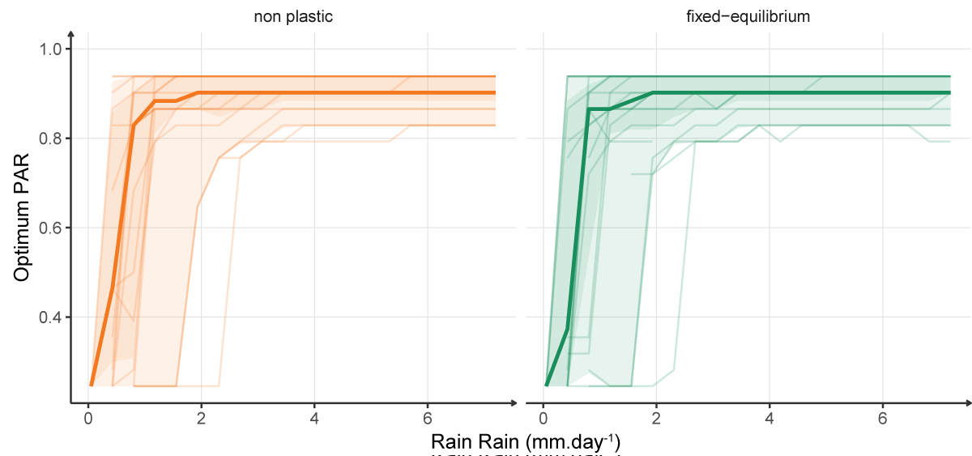
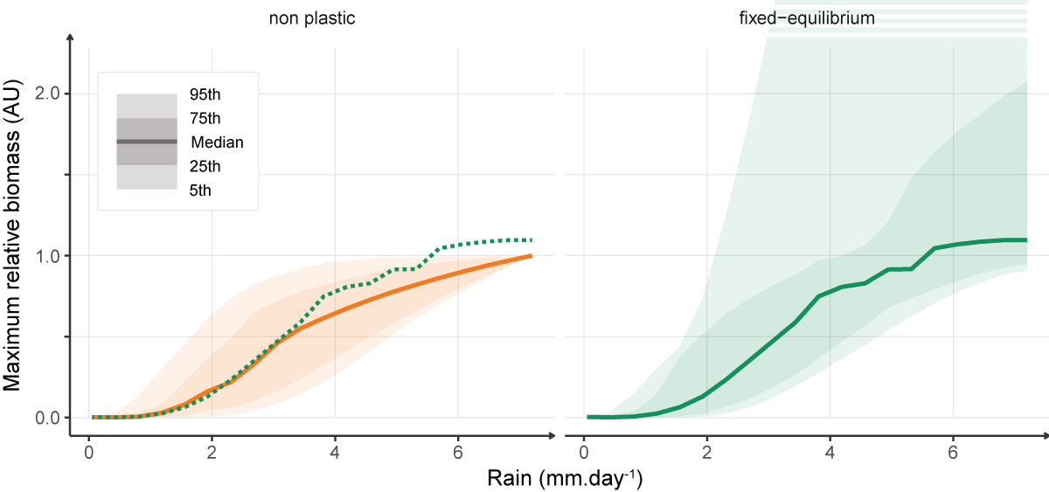
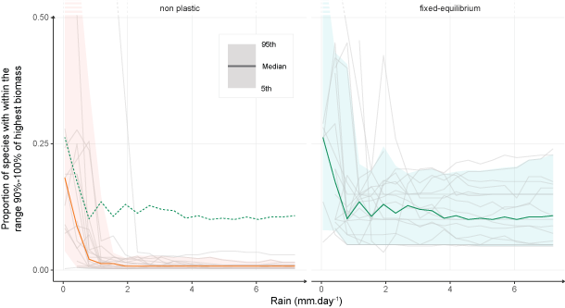
Homogeneous conditions & static gain
No shift in best strategy (proportion of active tissues)
Reduction of growth differences (not shown)
Little change in maximum biomass

Slide 42
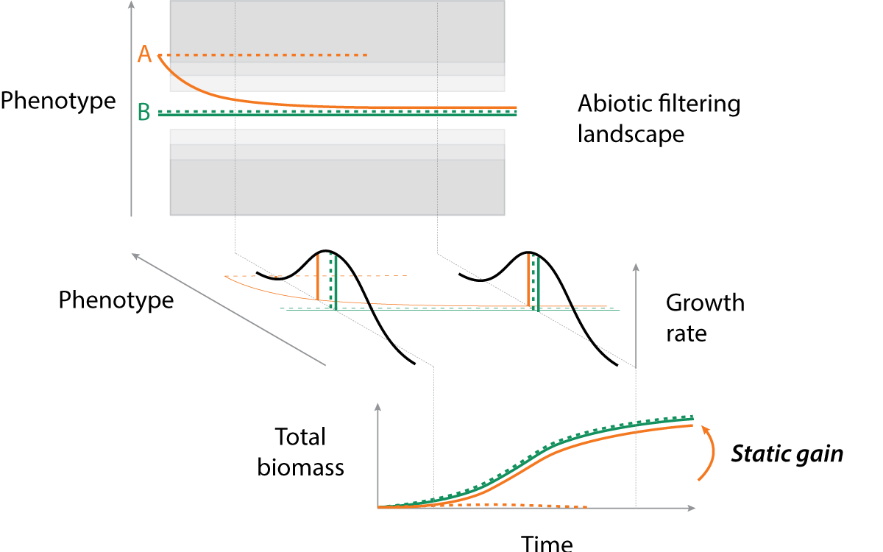
Static gain

Slide 43
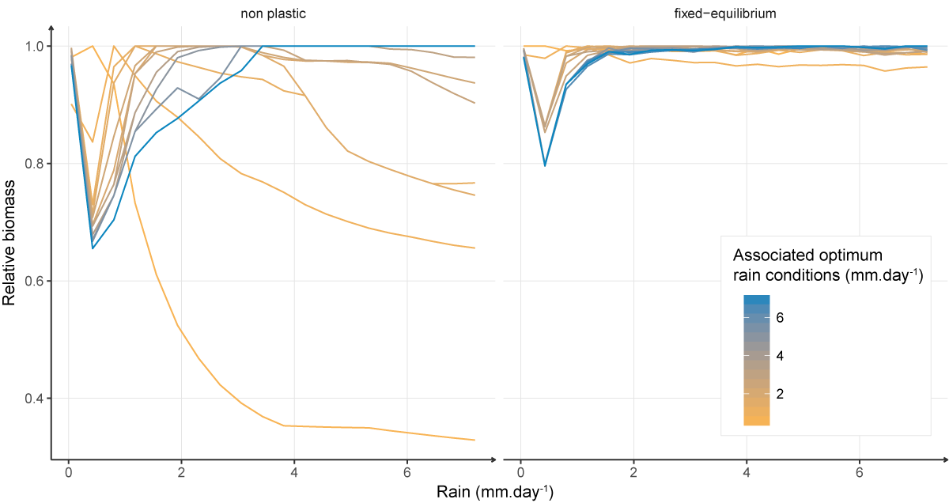
Widenning of the potential niche
Potential niche of the dominant species along the gradient
Increase in potential species diversity
But not functional diversity
No change in dominant strategies

Slide 44
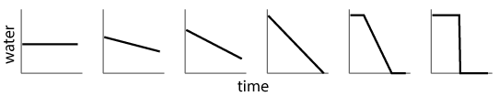
Simulation set-up
Simulation
N Parameter sets
M conditions
2 algorithms
Each simulation
Size, length, …

Slide 45
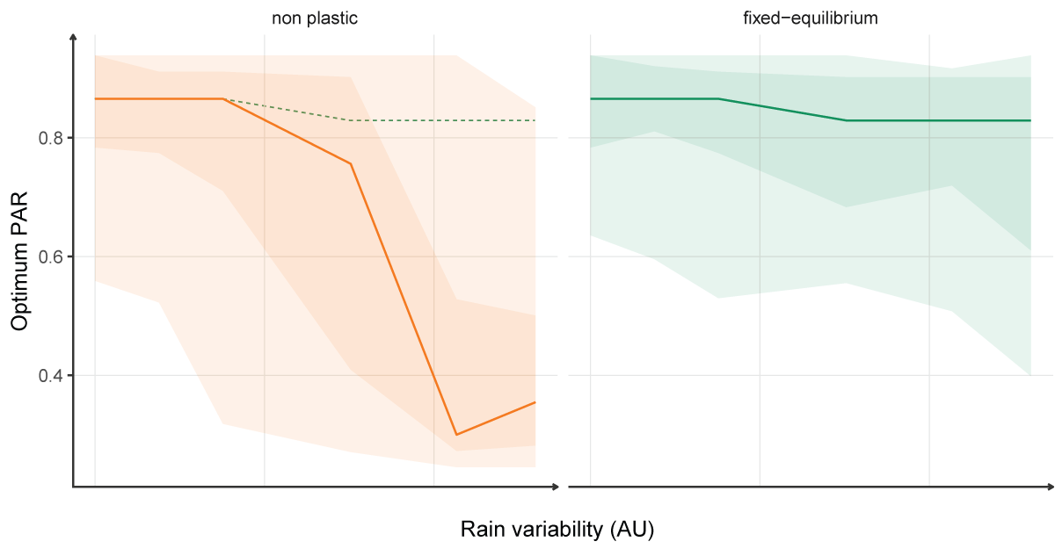
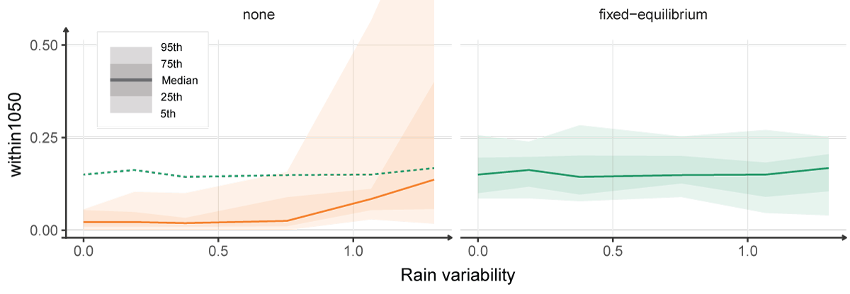
Heterogeneous conditions & dynamic gain
Increase of relative BM (~ n%)
Changes in dominant strategy (assymetric gain)
Reduction of growth differences

Slide 46
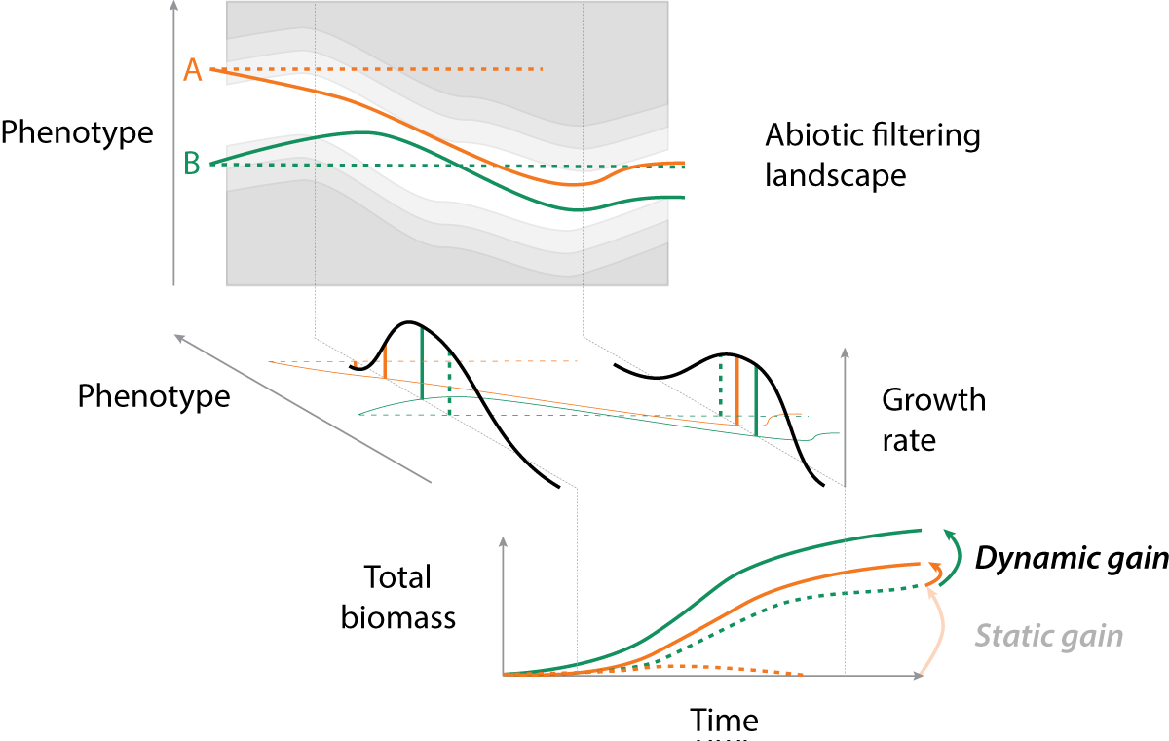
Dynamic gain

Slide 47
Consequences at the community level ?
Shift in dominant strategy
Higher potential species diversity
Competitive exclusion by exploitative species?

Slide 48
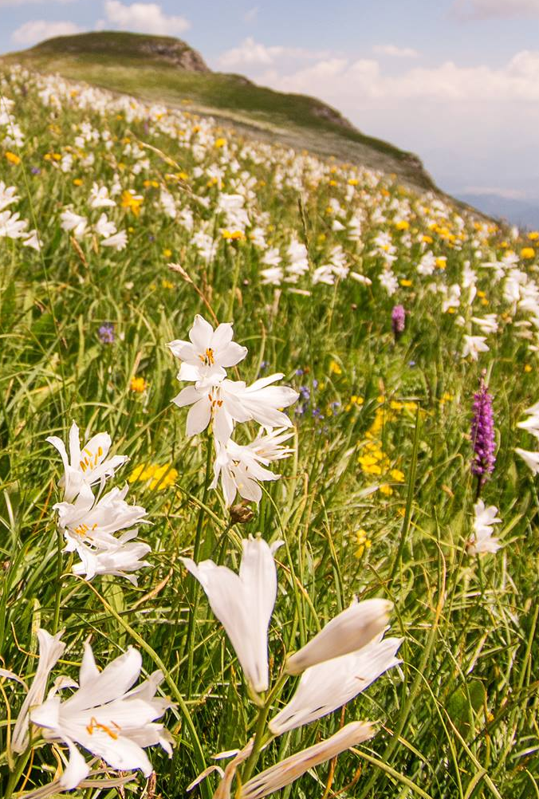
Community-level simulations
Community structure and diversity
The realised balance between mechanisms

Slide 49
Simulation set-up

Slide 50
Effect of the niche widening on diversity
reduction of fitness differences >> reduction of niche differences
Toward neutral situation
Effect on dominant strategy (asymmetric gain) ?

Slide 51
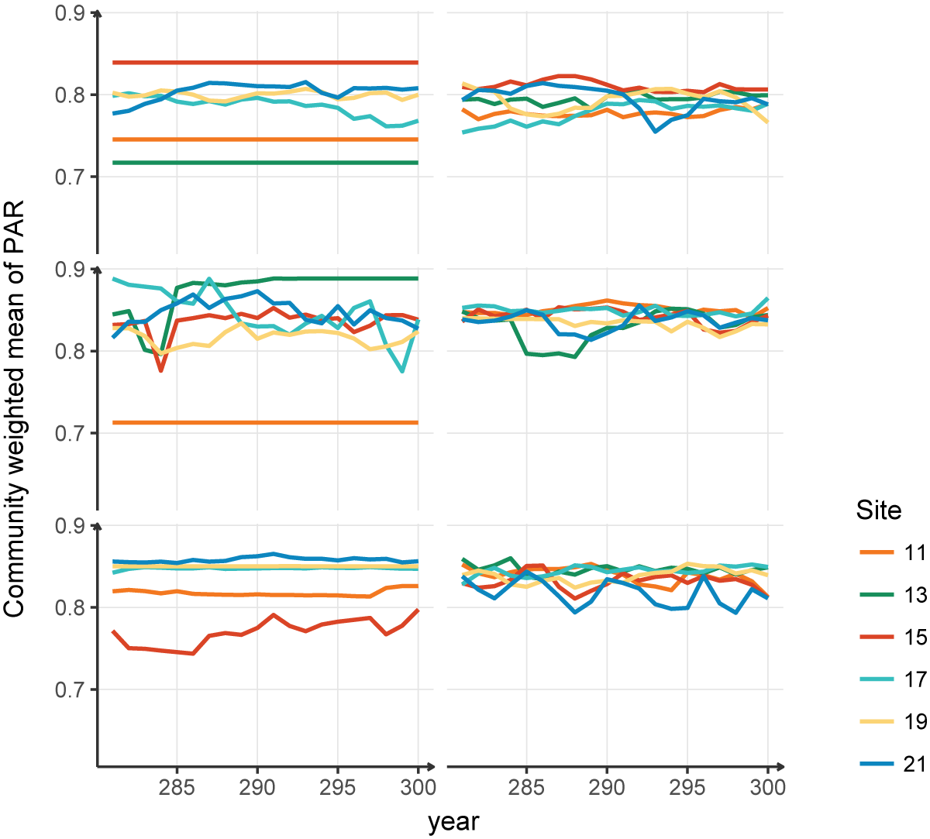
Dominant strategies variability
Effect on dominant strategy << effect on community structure
Yet, some differences should emerge (extended simulations needed)
Different meta-community structure

Slide 52
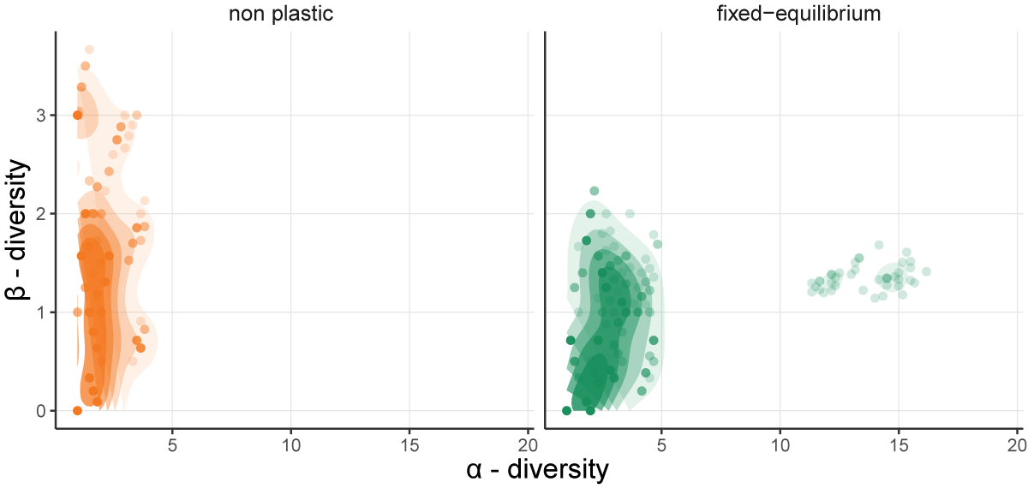
A shift in community structure
From distinct dominated communities to diverse communities with overlap
Niche overlap at the meta-community scale. Tissue efficiency more important than memory.
Reduces the importance of the Root:Shoot ratio axis → better sampling on the other two dimensions

Slide 53
Limits of the interpretation
Plasticity effect may be due to poor trait selection in the first place
Plasticity facilitates the exploration of strategy space: effect on species selection may be due more by static than dynamic gain
Poor overall diversity

Slide 54
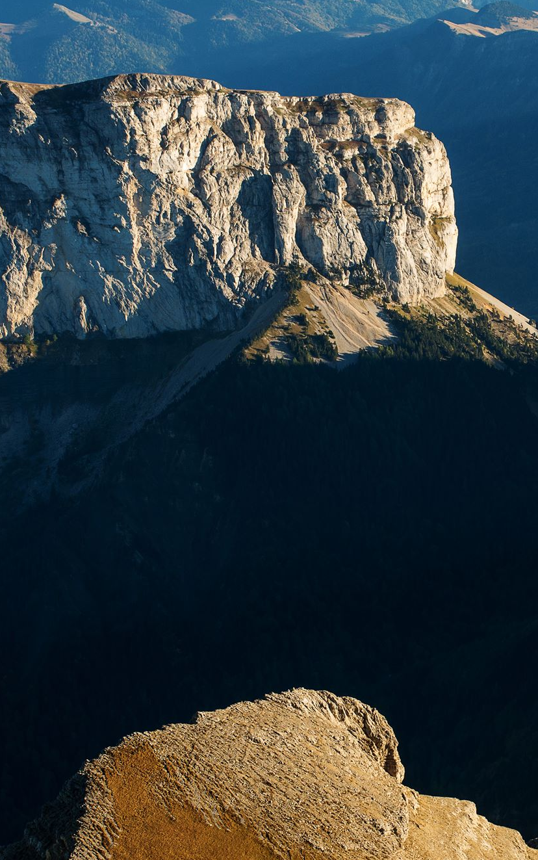
Discussion
5
Impact on community dynamics and community modelling

Slide 55
Commmunity dynamics and stability
Results → hypothesis → simulation plan + limitations
Community variability and overlap → soft abundance changes, not critical transition → but need to establish stable communities (better exploration of trait space) to be sure not just sampling

Slide 56
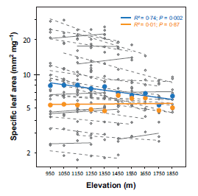
Convergence vs divergence
Solution:
Change assumptions
…but increase model complexity
Niche differentiation
Avoidance vs resistance vs resilience

Slide 57
The frontiers of plasticity
Traits are measures
Plasticity is a shift in what is considered constant (allometry, growth rate, growth traits, plasticity traits → genes?)
Measure of plasticity
Plasticity of plasticity traits
Plasticity = question of complexity of models
How deep should we go in the rabbit hole
Can we extract some general rule, behaviour that goes with the increasing complexity ?

Slide 58
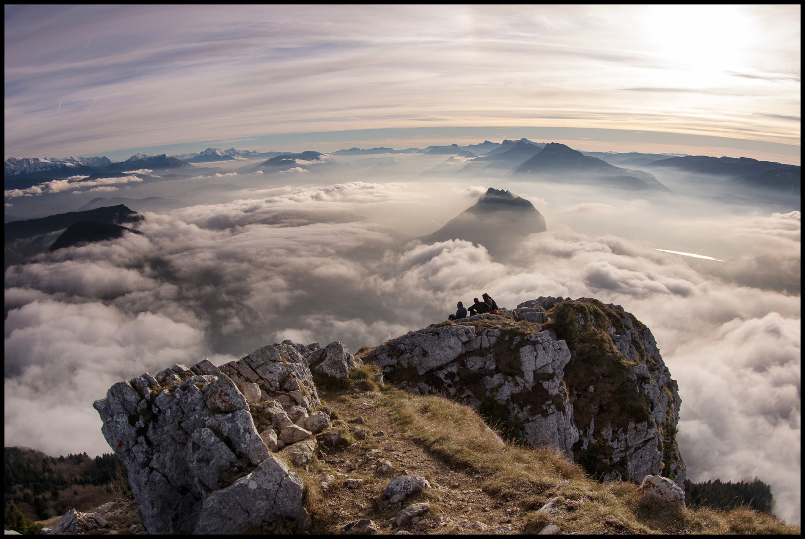
Conclusion & Perspectives
6
New hypothesis and simulations
Model developments

Slide 59
Diverse community framework
Diverse strategies
Resource dependant optimum
Integrated plasticity in coherent framework
Plasticity as a strategy
but…
Plasticity leads to high convergence, may need to diversify objective functions or assumptions…
Strategy space must be better sampled for each parameter set

Slide 60
Plasticity is more than ISV
Need to look at the process (even if not PP)
Niche widdening and competition reduction
Challenge strong hypotheses

Slide 61
To go beyond
Better calibration to confirm results
Explore the plasticity as a strategy
Climate scenarios
Management and perturbations
Stability/invasibility
New forms of plasticity
+ exploration of other strategy axis (reproduction, frost resistance)
→ Multi-risk plasticity framework
Epigenetics

Slide 62
Thank you

